Slide 1
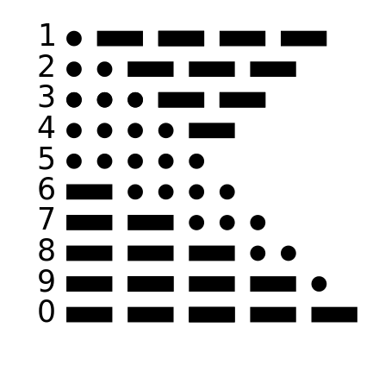
미니 프로젝트 2 (1주간)
t0
tn
Morse Code (당일 과제)
Morse Code (주간 과제)
몰스 코드 해독기
Seven segment ‘1’
https://mil.ufl.edu/3701/docs/quartus/rom_creation_91_sp2.pdf
LPM_ROM 활용
https://www.intel.com/content/www/us/en/programmable/quartushelp/13.0/mergedProjects/reference/glossary/def_mif.htm

